Slide 1
Forecasting of VNFs metrics for virtualized communication services
Jaafar Bendriss 1,2, Imen Grida Ben Yahia 1, Djamal Zeghlache 2
1 Orange Lab Networks (OLN), Châtillon, France
2 Telecom SudParis, Evry, France
Notes:
Abstract ( goal focus on forecasting)
Software Networks built by combining Software Defined Networks (SDN), Network Function Virtualization (NFV) and Cloud environment call for agile and dynamic automation of management operations to ensure continuous provisioning and deployment of networked resources and services. In this context, efficient Service Level Agreements (SLA) management and anticipation of Service Level Objectives (SLO) breaches become essential to fulfill established service contracts with clients. In this paper, we design and specify a framework for cognitive SLA enforcement (using Artificial Neural Network learning) for networking services involving (Virtualized Network Functions) VNFs and SDN controllers. A proof of concept, a test bed description and an extensive evaluation and discussion assess the performance of the proposed framework.
I

Slide 2
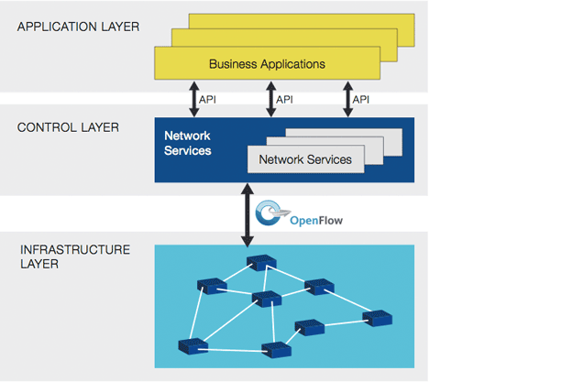
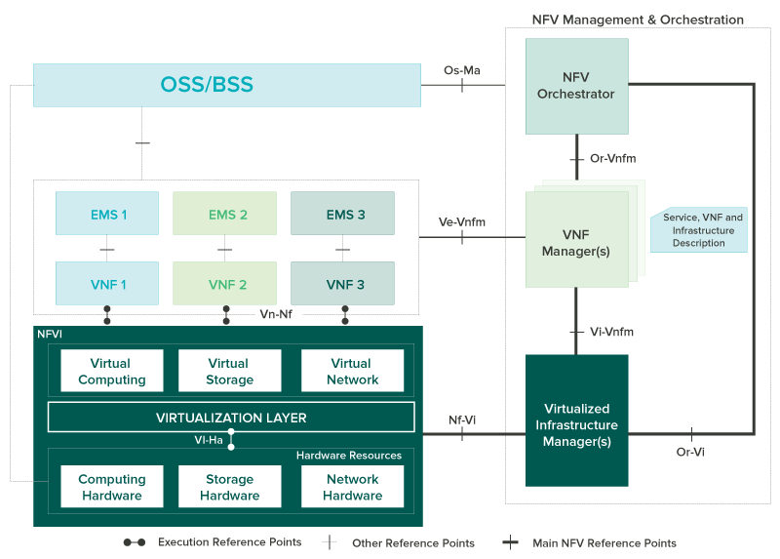
Challenges of SDN and NFV combined environments
SDN
List of challenges wr.t. to SLA:
Centralize management
Open API
Network abstraction
NFV
List of challenges w.r.t. SLA:
Agile nature of VNFs
Continuous provisioning
end-to-end orchestration
Notes:
The emerging Software-Defined Networking (SDN) and Network Functions Virtualization (NFV) paradigms are accelerating the transformation of proprietary and static traditional networks towards open and programmable networks composed dynamically. Both use cloud infrastructures and services as enablers. SDN builds programmable networks through abstractions, open APIs (northbound and southbound) and the separation of control and data planes. NFV targets the virtualization of network functions and aims at reducing vendor lock-in and bringing agility in the services and resources lifecycle operation and management. The IT and networking industries foresee a combined use of SDN and NFV to make cloud and network services agile. Major service and network providers predict that, by 2020, 70% of deployed networks will rely on cloud infrastructures, virtual network functions and multi-domain SDN controllers. This vision can only materialize if automation of dynamic cloud and network services production and deployment are introduced and fully integrated in cloud architectures. This includes 1) faster deployment (from months down to minutes); 2) continuous provisioning in line with the dynamic nature of VNFs subject to up and down scaling; 3) e2e orchestration to ensure coherent deployment of IT and network infrastructures and service chains for example and 4) service assurance for fault and performance management including new monitoring and resiliency approaches.
This evolution and new requirements call for efficient SLA enforcement and management. ITU-T defines SLA as a formal agreement between two or more entities that is reached after negotiation with the scope to assess service characteristics, responsibilities and priorities of every part[1]. Guaranteeing SLAs and developing means to detect SLA and SLO violations in monitored virtualized network functions become major concerns for networks and services providers.
To the best of our knowledge, SLA management for the combined and joint use of SDN, NFV and clouds has not been addressed yet. Novel approaches to meet these new SLA and SLO management are needed. In this paper, we propose a cognitive SLA enforcement approach that relies on learning techniques to identify SLOs breaches for combined SDN and NFV scenarios. The goal and proposed approach consist in computing and processing in real time the Key Performance Indicators (KPIs) and SLOs to derive predictive models capable of learning and pointing out possible SLO breaches and anticipate by enforcing management actions.
Section II of this paper reviews the related work. Section III describes our proposal for a cognitive SLA enforcement. Section IV introduces our learning model and design choices. Section V presents our testbed and evaluation. Section VI discusses the results and presents foreseen future work.

Slide 3
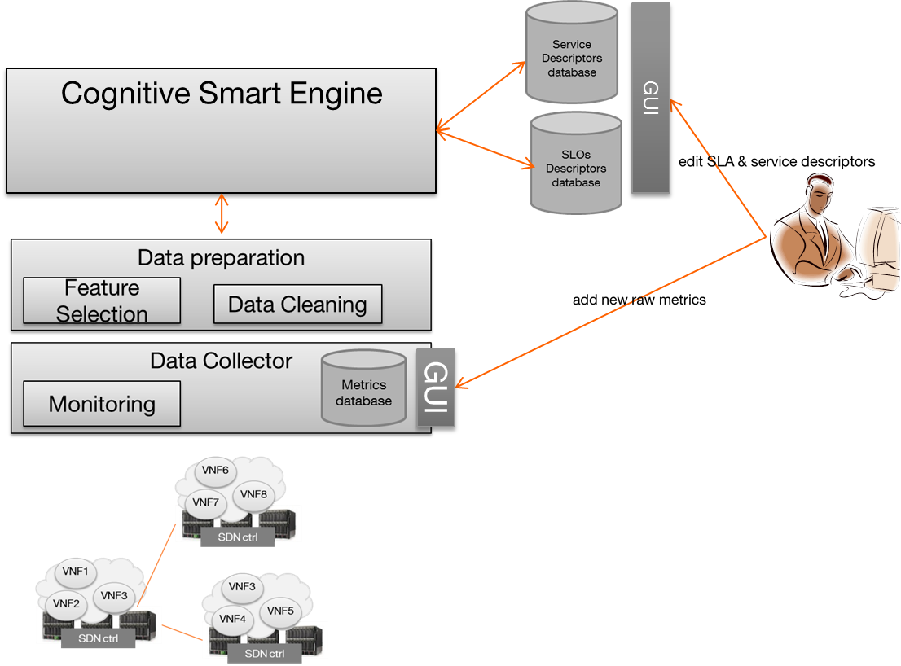
Goal: Cognitive SLA enfocement
Networking service
Notes:
We define a Cognitive SLA enforcement as to the process by which operators maintain the compliancy of services and their predefined SLA while using as a cornerstone a computed knowledge with machine learning techniques.
It is important to recall that predefined SLA and service description and monitored data are mandatory inputs to ensure cognitive processing.
Figure 3. Cognitive SLA enforcement architecture
In this regards, we propose the following building blocks for the Cognitive SLA enforcement, as depicted in Figure 3 and in the sequence diagram of Figure 4:
Data Collector: The data collector encompasses all the monitoring and storage aspect of our framework. It collects raw metrics (e.g. cpu.idle_perc, disk.space_used_perc, net.out_packets_sec, process.cpu_perc) from the monitored service streaming, it includes the running VMs, VNFs and virtual switches. It then stores them in a time series database. These data are made available to the Data Preparation and Preprocessing block.
Data Preparation and Pre-processing: This step consists on selecting the features to be followed for the learning. It also ensures the data filtering and cleaning. There are two possibilities, these data are then stored into the Data Storage block or transmitted to the Cognitive Smart Engine for near real time processing. The data storage is then the repository of the pre-processed and filtered data.
In this regard, and for the definition of feature, we select the following dimensionality: VNFs network related metrics, VNFs performance, VNFs memory and VNFs disk usage
Cognitive Smart Engine (CSE)
The CSE is the core component of our framework. It has interfaces with the data preparation block. The CSE relies on two main modules:
 CSE/Forecasting
 CSE/Violation prediction
 CSE/SLA enforcer
The CSE/Forecasting module takes as inputs the preprocessed and filtered data and computes the forecasted values i.e. the next step ahead values of the given inputs. More details are given in section IV-C. The forecasted values are fed to the second CSE/Violation prediction module to identify (if any) the most probable affected/violated SLO based on the one-step-ahead value. To do so, CSE/Violation prediction module has direct access to repositories where Service, SLA and SLOs descriptors are predefined and stored.

Slide 4
Data collector
Python client connected to Monasca API
Data are collect as a Dictionnary and transformed to DataFrames
DataFrames can be stored as CSV files
DataFrames can also be stored in a column-based Database, e.g. HBASE.
OpenTSDB is also used to store Time Series Database
Notes:
Data Collector: The data collector encompasses all the monitoring and storage aspect of our framework. It collects raw metrics (e.g. cpu.idle_perc, disk.space_used_perc, net.out_packets_sec, process.cpu_perc) from the monitored service streaming, it includes the running VMs, VNFs and virtual switches. It then stores them in a time series database. These data are made available to the Data Preparation and Preprocessing block

Slide 5
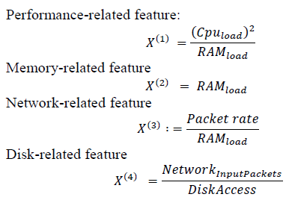
data preparation
Data preparation is a key phase in the machine learning pipeline
Data Cleaning:
removing null and redundant values
scaling and normalizing the dataset
Feature selection:
creating a new set of features from the available ones.
selecting the most efficient features
Notes:
Data Preparation and Pre-processing: This step consists on selecting the features to be followed for the learning. It also ensures the data filtering and cleaning. There are two possibilities, these data are then stored into the Data Storage block or transmitted to the Cognitive Smart Engine for near real time processing. The data storage is then the repository of the pre-processed and filtered data.
In this regard, and for the definition of feature, we select the following dimensionality: VNFs network related metrics, VNFs performance, VNFs memory and VNFs disk usage. In this block also, the data is normalized to values ranging from 0 to 1: 𝑋𝑗= 𝑋𝑗Σ𝑋𝑁𝑖=1𝑖

Slide 6
Cognitive Smart Engine
The module where the Artificial Neural Network Model is implemented.
We used a FFNN, Feed-Forward Neural Network
Notes:
Zoom on the CSE/ Violation prediction Module
It takes as input the forecasted values for the next hour or half an hour, reads the SLA descriptors and computes the violation probability for each SLO. It then selects the SLO with the highest probability to be affected and violated. For that, we fixed a certain threshold.
This process is repeated for each VNF. It then triggers two actions: Firstly, it sends a notification in the form of a warning message, and then sends the potential violated SLO to SLA enforcer module to trigger the necessary management procedures (e.g. replication action, resource allocation, traffic redirection, scale In/Out, etc.) in order to counteract and avoid SLO breaches. We call this a short control loop.
CSE/Violation and prediction module performs its operation per VNF basis. In the offline stage, the system computes the dependencies between the features used as inputs in the CSE and the SLOs in the repositories.
Figure 4. interworking of Cognitive SLA enforcement building blocks
This process is repeated for each VNF. It then triggers two actions: Firstly, it sends a notification in the form of a warning message, and then sends the potential violated SLO to SLA enforcer module to trigger the necessary management procedures (e.g. replication action, resource allocation, traffic redirection, scale In/Out, etc.) in order to counteract and avoid SLO breaches. We call this a short control loop.
CSE/Violation and prediction module performs its operation per VNF basis. In the offline stage, the system computes the dependencies between the features used as inputs in the CSE and the SLOs in the repositories.
Besides the short control loop mode described above, another mode namely long control loop is described in our previous work described in our previous work [13]. Basically, the long control loop aims to learn from experience and past events. It acts in an offline mode and updates the predictive model to discover new patterns or trends in the data traces. An example of its operation is when an SLA violation occurs: The control loop assesses the errors and adjusts the predictive model accordingly.

Slide 7
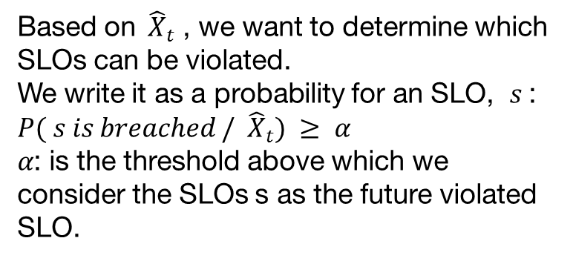
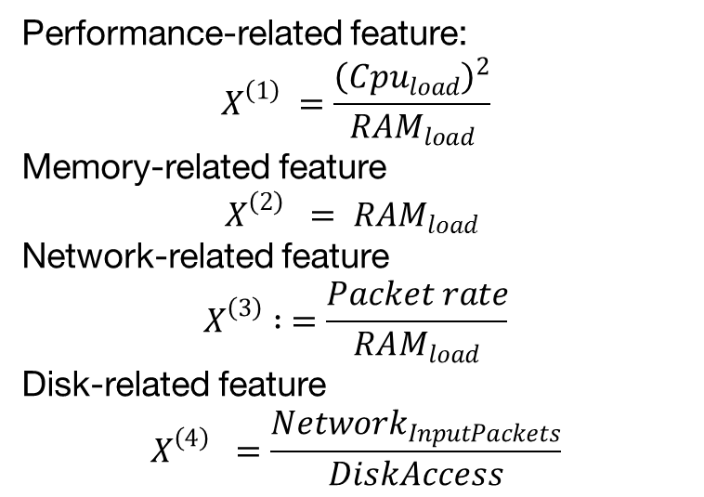
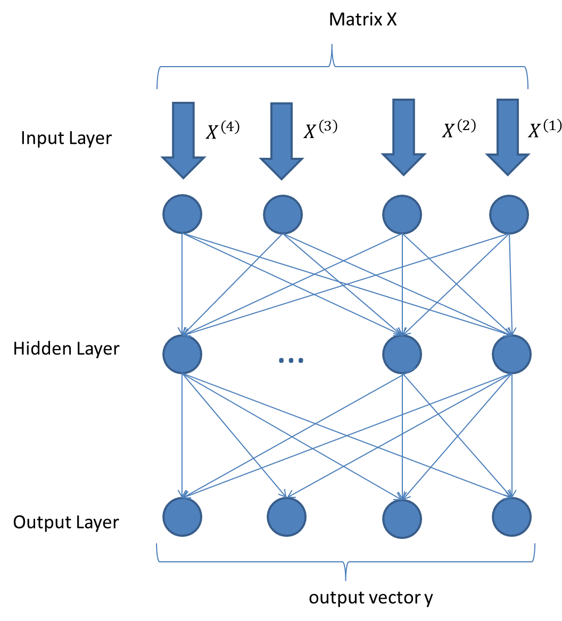
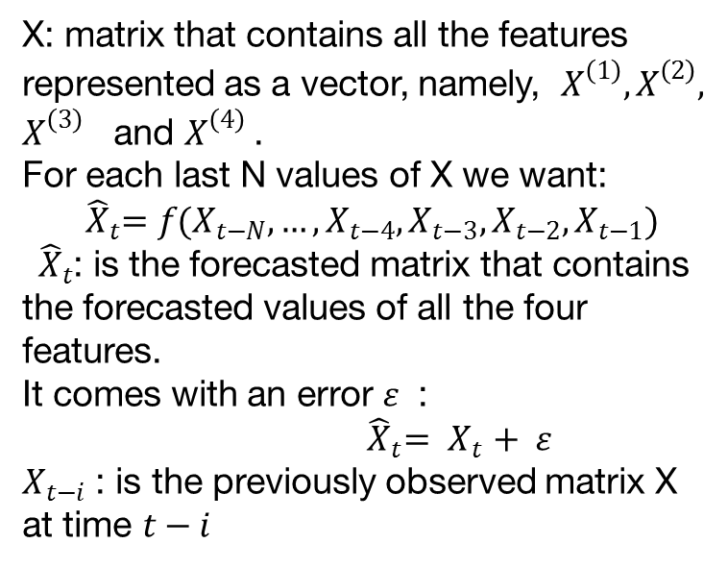
Machine learning: How ML is being applied to solve it
(1)
(3)
(4)
(2)
Notes:
In this paper we define a Time series as a sequence of observations ordered in time at regular intervals 𝑠𝑡 𝜖 ℝ [14] [15] e.g. meteorology weather variables, electric loads, a VNFs memory usage over time.
A model as is a mathematical formulation that describes the process by which time series are generated [16]
Forecasting is the process by which we apply a model to time series and computing the predicted output. The error between the predicted output and the real output is: 𝑠𝑡+1 =𝑔(𝑡)+ 𝜀 𝑡=1,…,𝑇
Where the function 𝑔 is the model, 𝑠𝑡+1 is the predicted value and 𝑇 is the number of observations and 𝜀 , the error terms that follows a probability law.
The term prediction in this context is different from forecast. The prediction means interpretation of forecasted values to identify which SLOs could be impacted.
In the machine learning realm, problems are classified as either regression problems or classification problems. Classification is when the output of the system is determined into a limited set of classes, e.g. SLO breach, No SLO breach. Regression is when the output is a real value, e.g. determining the price of a house.
Artificial Neural Network – ANN is a machine learning technique inspired by the biological functioning of neural cells in the brain. They are composed of interconnected neurons (or nodes) which process information in a simple way (e.g. summation, multiplication). Moreover, each node can locally apply to its inputs a function (called the activation function).
The ANNs have a very powerful generalization capacity. They can learn from a limited datasets and successfully generalize to new examples.
ANNs have traditionally been used for classification problems [17]. They have been successfully used in a wide variety of domains, from speech recognition to image recognition. Forecasting is also a major area for ANN [17].
As aforementioned, we choose for the forecasting problem the FFNN. FFNNs also known as Multi-Layered Perceptron’s (MLP). They are composed of several layers. Each layer contains nodes that are fully connected to the nodes the adjacent layer. The First layer is the input layer; the last one is the output layer and in between are the hidden layers.
The ANNs are generally referred to as black boxes. They take inputs, perform complex calculations, and output the desired results. Internally, the FFNN has a weight matrix Θ and node biases that is used to stress the role of each node.
ANN parameters and architecture: The length of the input vector in the ANN is equal to the number of nodes in the input layer. The size of the input layer is also equal to the size of the moving window along the time series. Determining the appropriate number of input nodes for forecasting problem is not a trivial task.

Slide 8
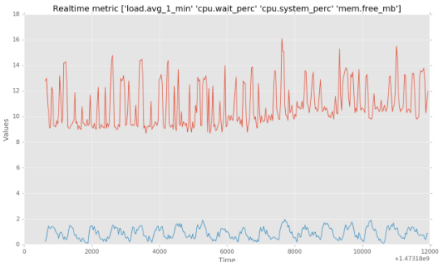






Analytic Platform
Data collector
Data preprocess.
Cognitive Smart Engine
OpenTSDB
Hbase
Data
Cleaning
Feature
Selection
Forecasting
Viol. Prediction
SLA enf.
Monasca
server
Monasca REST API
Agent
Agent
Agent
Agent
Agent
Agent
Notes:
Our testbed is composed of five Virtual Machines running on Ubuntu server with 16 GB of RAM and 4 vCPU for each VM.
We instantiate the Monasca server in the first VM, Openstack in the second VM, this VM plays the role of the authenticator using Openstack keystone. The third and fourth VM host our virtual network, composed of Virtual switches (Open Vswitch) and multiple VM guests. The guests correspond to three clients, three servers and five vSwitches, and one OpenDaylight controller. The figure 6 depicts how we design our virtual network. The goal of this architecture is to allow the creating of multiple paths between the sources (i.e. streaming servers) and the destinations (i.e. the clients) using RTP streaming protocol. In the fifth VM, we construct our CSE.
The select monitoring tool for our framework is Monasca [18]. Monasca is a MaaS, Monitoring-as-a-service solution from HP, built as a highly scalable openstack service. It uses Apache Kafka queue technology[19] to prioritize incoming flow and InfluxDB [20] as a time series database.
The advantages of Monasca over current monitoring solutions (e.g. Zabbix, ceilometer) are than it is highly scalable, integrated as an Openstack project and it allows us to define new set of metric for our research problem.
In each VM guest, we instantiate a monitoring agent (Monasca agent). The agent retrieves the local information and sends it to the Monasca server.
The Monasca server in turn, receives all the data generated in the form of time series from several data point and data source (e.g. VMs hosting VNFs, PMs, virtual switches) that are monitored by Monasca agents. In our example, the monitoring interval (data pushed by Monasca forwarder in Monasca agent) is the default 30 sec
The Monasca server then stores all the incoming data in InfluxDB, an open source database for storing and managing time series. The persistence of the stored data is up to 30 days.
Using the Monasca REST API, we can retrieve at real-time all the stored metrics. This should in turn be selected and filtered before feeding the CSE.
Each streaming VNF runs locally in an infinite loop a high video quality (720p) of one hour and a half broadcasted over Real-time Transport Protocol (RTP) video streaming protocol. Each client accesses and reads the video in its original format, which generates a network stream over the two end-points. Once the streaming service is up and running, the three VM clients are connected and receive the video streaming, we start by injecting 4 types of faults. (1) Node failure, (2) link failure, (3) node overload, and (4) link overload.
The aim of fault injection is to generate training example for the ANN as in Figure 7 to learn on and then to generalize to other similar types of faults patterns.
The testbed generates several traces that are reshaped as stream of matrixes with 20 rows (5 inputs per feature * 4 features) which corresponds to the size of the sliding window onds.

Slide 9
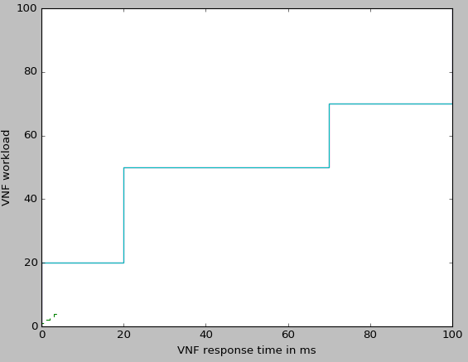
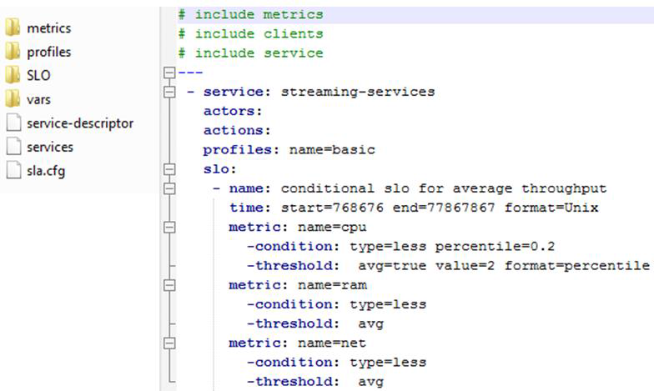
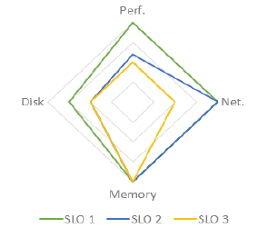
SLA definition
Notes:
B. SLOs Breaches: Problem formalization
As stated before, the SLA studies are applied to a streaming service running on top of virtualized and softwarized infrastructure (SDN and NFV). The following assumptions at time 𝑡 are considered
− Recurrent patterns exist within each metrics
− There exist correlation between different metrics in the network (e.g. CPU, network utilization )
− Network centric metrics can affect streaming service quality
− The service quality metrics can be defined from one or many available metrics (e.g. maximum, percentile, average, etc…).
We want to infer the future behavior of the service and the underlying network at time 𝑡+1 (e.g. in the next hour or half-hour). More, based on these forecasted values, we want to determine if any SLOs are impacted.
We refer to the set of variables that captures the service and network principal characteristics as features. Considering that a service is a set of: interconnected VNFs; virtual links; VMs; and ports, etc.

Slide 10
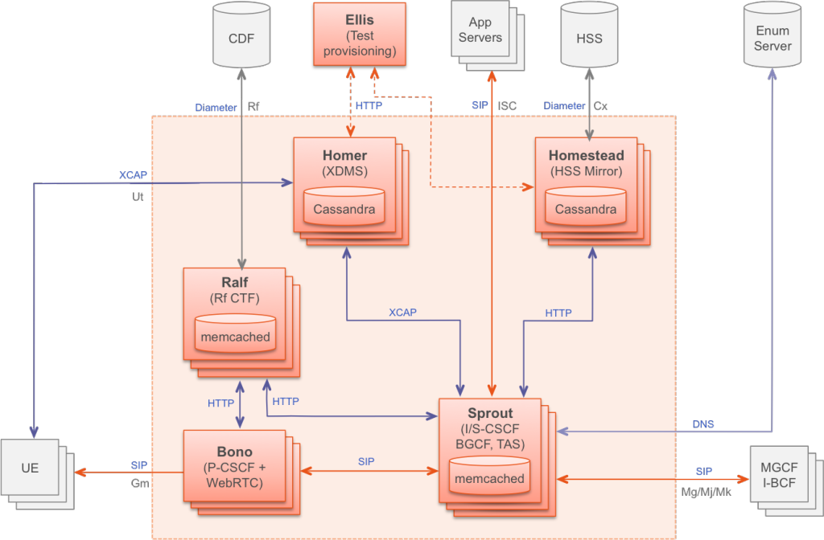
Use case: VOIP on top of clearwater vIMS
Notes:
COPY/PASTE:
Project Clearwater (http://www.projectclearwater.org/) is an open source implementation of an IMS that is built for the cloud and hence can achieve massive scalability and cost effectiveness. Clearwater provides SIP-based call control for voice and video communications and for SIP-based messaging applications. Clearwater follows IMS architectural principles and supports all of the key standardized interfaces expected of an IMS core network. When deployed as an IMS core, Clearwater does everything that you’d expect an IMS core to do, incorporating Proxy CSCF (Call Session Control Function), Interrogating CSCF and Serving CSCF, together with Breakout Gateway Control Function. Clearwater also includes a WebRTC gateway, and natively supports interworking between WebRTC clients and standard SIP-based clients, using SIP over WebSocket signaling. Since Clearwater was designed from the ground up to run in virtualized environments and take full advantage of the flexibility of the Cloud, it is extremely well suited for NFV. Its architectural features include the following:
The user equipment (UE) makes a request to Bono – that is the proxy CSCF node providing a SIP IMS Gm compliant interface.
Bono uses Sprout (SIP Router) that is a horizontally scalable, combined SIP registrar and authoritative routing proxy, that handles client authentication and the ISC interface to application servers. Sprout implements most of the I-CSCF and S-CSCF functionality. The Sprout cluster includes a redundant memcached cluster storing client registration data and other long-lived state. SIP transactions are load balanced across the Sprout cluster, so there is no long-lived association between a client and a particular Sprout node.
Homestead (HSS Mirror) provides a Web services interface to Sprout for retrieving authentication credentials and user profile information. Homestead nodes run as a cluster using Cassandra as the store for mastered/mirrored data. In the IMS architecture, the HSS mirror functions are considered to be part of the I-CSCF and S-CSCF components, so in Clearwater I-CSCF and S-CSCF functions are implemented with a combination of Sprout and Homestead.
Ralf (Rf CTF) provides Rf Charging Trigger Function, which is used in IMS to provide offline billing. Bono and Sprout report P-CSCF and I-CSCF/S-CSCF chargeable events respectively to Ralf, which then reports these over Rf to an external Charging Data Function (CDF). As the other components, Ralf nodes run as a cluster, with session state stored in memcached cluster. (Storage of session state is required to conform to the Rf protocol.)
Homer (XDMS) is a standard XML Document Management Server used to store multimedia telephony (MMTel) service settings documents for each user of the system and uses a standard XCAP interface. Homer nodes also run as a cluster using Cassandra as the data store.
Ellis is a sample provisioning portal providing self sign-up, password management, line management and control of MMTel service settings.

Slide 11
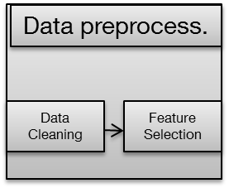
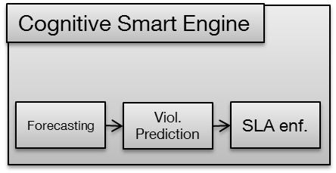
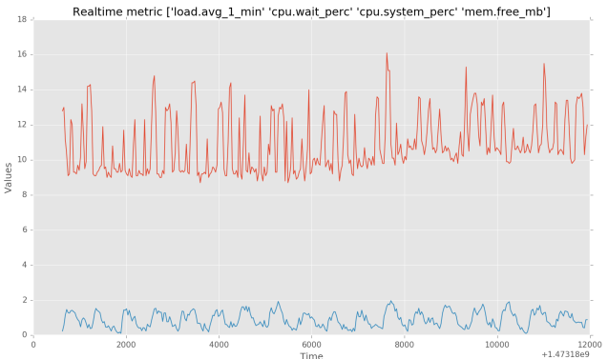
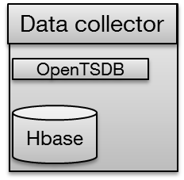

TestBed
Agent
Agent
Agent
Agent
Agent
Agent
Notes:
new parag

Slide 12
use case: focus on data
Motivations:
Reducing the Up-frontcosts
More flexibility to growing enterprises
Fast service deployement

Slide 13
use case snapshots and live demo
Pre-processing
Learning
Forecasting

Slide 14
use case : Evaluation
Evaluation metrics
How to performe the Evaluation
Learnig, Cross-Validation, Validation
Conclusion
Notes:
B. Evaluation methodology
To be coherent with our SLOs definitions, we have chosen to reduce the size of the global stream by averaging all the data in 10 minutes: a bursty load of few seconds is thus not considered as an SLA/SLO violation, since this happens frequently in the observable workload. Furthermore, this methodology allows us to reduce the size of the input stream.
We evaluated our framework accuracy in an offline mode, using data gathered on a period of four weeks, with several SLO breaches (using fault injection), trends and patterns. The FFNN learns to predict one-step-ahead value for the next 30 minutes.
The data was divided into 3 subsets, namely the training set approximately 70%, cross-validation set 10% and a validation set of 20%. We trained multiple FFNN and RNN architecture as shown in table 2. Then we performed our tests on the validation set.
For the LSTM we used an off-the-shelf library called PyBrain [21], we used it to compare the results yielded by our framework. The evaluation of the LSTM was performed using the same training and testing set.
In the literature, RMSE - Root Mean Squared Error - was widely adopted to evaluate the accuracy of ANN among other ML methods. We adopted the same approach to compare different FFNN and LSTM architectures.
The results are summarized in Table1 and are discussed in the next section.
Besides RMSE, we evaluated our learning algorithm using precision and recall metrics. These metrics are essential when working with skewed classes (i.e. when the number of one class (no SLO breach) largely outnumber the other classes (SLO breach))
The precision metric evaluates the accuracy of our predictions in detecting correct SLO breaches. It is given by the equation in figure 8, where, True positive are the correctly identified SLO breaches and false positive, false/incorrect SLO breaches identified by the system. The higher the precision the better is the result.
On the other hand, recall answers the question: of all SLO breaches what fraction did the algorithm correctly detect. Recall is given by the second formula in figure 8, where false negative is the SLO breaches undetected by our Framework.
Additionally, and in order to have a single number to evaluate our framework, we used F-score metric. F-score is a robust metric to generate a single value metric from two variables.
Figure 8 Precision, Recall, F-Score equations
The validation data set comprises 87 SLO_1 breaches, 52 SLO_2 breaches and 122 SLO_3 breaches. We summarized our second results in Table 2 in the next section.

Slide 15
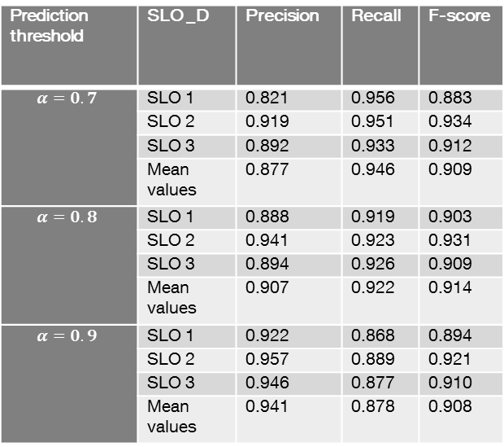
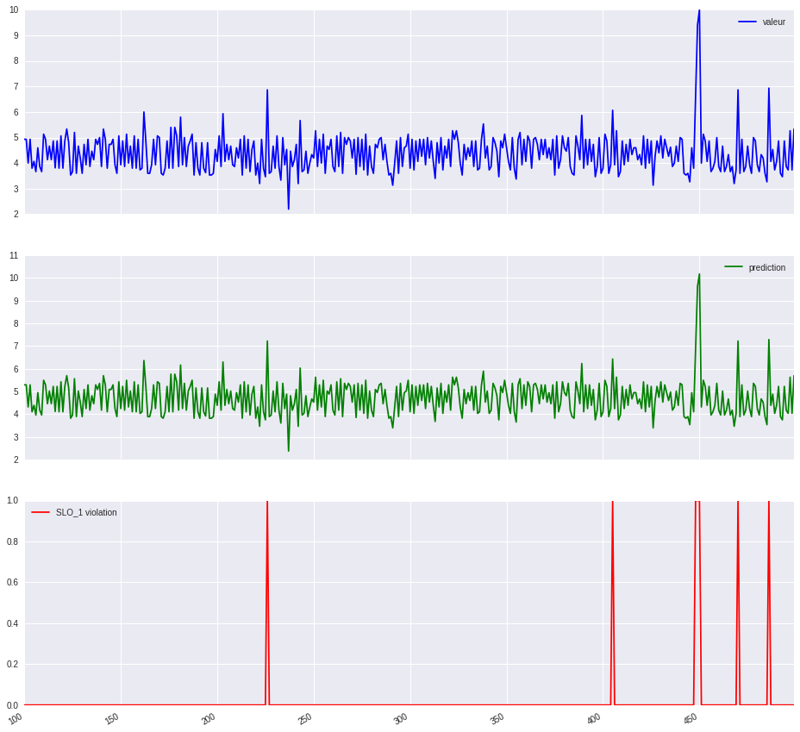
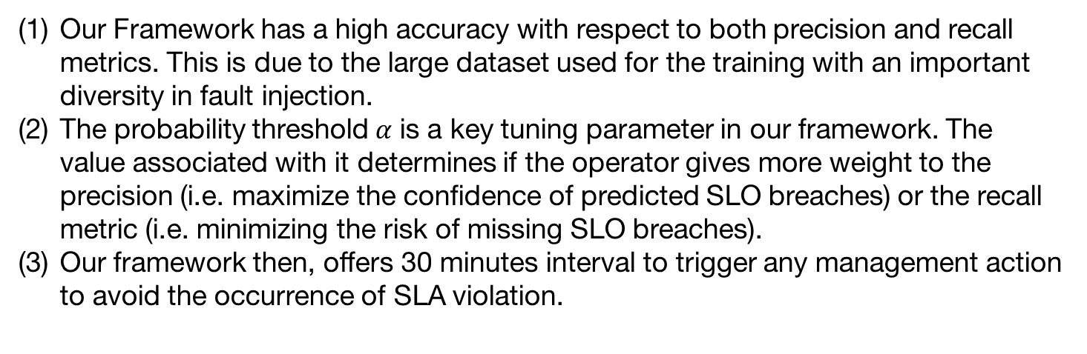
Preliminary results
Our Framework has a high accuracy with respect to both precision and recall metrics. This is due to the large dataset used for the training with an important diversity in fault injection.
The probability threshold $α$ is a key tuning parameter in our framework. The value associated with it determines if the operator gives more weight to the precision (i.e. maximize the confidence of predicted SLO breaches) or the recall metric (i.e. minimizing the risk of missing SLO breaches).
Our framework then, offers 30 minutes interval to trigger any management action to avoid the occurrence of SLA violation.
Results of offline evaluation mode of the FFNN with three different SLO breach threshold
Example of SLO breaches Identification.
Notes:
C. Evaluation Results
We initialized the LSTM parameters with 60 cycles (i.e. the data passed through all the nodes) and 10 epochs per cycle (i.e. one epoch is when the LSTM sees all the training data).
The first remarkable contrast in Table 1 is that the LSTM is computationally more expensive that the FFNN, with a relatively lower RMSE.
Overall the training time of the ANN is considerable and it is highly correlated with the architecture especially, the number of nodes in the hidden layer. Moreover, we noticed that after a certain RMSE value adding ANN node does not significantly improve the forecasting accuracy.
Table 1. Comparison of different FFNN and LSTM architecture
In Table 2, we classified our results according to the threshold used by the SLO violation module 𝛼. Recall that 𝛼 is the threshold that determines whether a set of forecasted values are considered as violation SLOs or not.
We present in table 2 for each 𝛼 the three SLOs with their respective precision, recall and F-score evaluation metric.
We then compute the mean for each metric to summarize the impact of 𝛼 on all the SLOs.
From Table 2 we draw two conclusions:
(1) Our Framework has a high accuracy with respect to both precision and recall metrics. This is due to the large dataset used for the training with an important diversity in fault injection. (2) The probability threshold 𝛼 is a key tuning parameter in our framework. The value associated with it determines if the operator gives more weight to the precision (i.e. maximize the confidence of predicted SLO breaches) or the recall metric (i.e. minimizing the risk of missing SLO breaches).
In other words, s small 𝛼 means that the system will detect most SLO breaches but with a higher risk of false positive, whereas a higher 𝛼 yields a higher precision with a larger false negative.
Additionally, we classified our results in Table 2 according to the threshold used by the SLO violation module 𝛼 to determine if a forecasted value is considered as impacting an SLO or not.
Figure 9 shows that the FFNN captures to a high degree the pattern in the traces with correct identification of SLO_1 breaches; however we note here that some errors remain in the amplitude of the forecasted values, thus generating false positives or false negatives.
Our framework then, offers 30 minutes interval to trigger any management action to avoid the occurrence of SLA violation.

Slide 16
Conclusions and next steps: Describe your plans for Y2
From a cognitive architecture perspective, we consider adding a policy engine that will translate and compute from the machine learning outputs the needed management actions to avoid any SLOs/SLA violation.
From a testbed perspective
involving the SDN controller in the management actions for remediations
adding distributed VNFs, with the Clearwater, the open vIMS platform
From ML perspective
use of other approaches such SVM to compare and propose recommendations of ML
Notes:
We specified, developed and evaluated in this paper a novel approach to enforce SLA in Programmable networks (SDN and NFV). We have based our work on substantial related work done in the area of ANN for regression and forecasting, SLA enforcement in the cloud environment. In this paper, we defined and evaluated modules that allow the forecasting and prediction of SLOs breaches for a streaming service running on NFV and SDN infrastructure.
− From a machine learning perspective, our evaluations show that LSTM is very robust when it comes to predicting a one step ahead in a sequence. In this work we considered only the data for streaming service and the underlying networks, one can consider a multi-tiered approach. This means the combination of data from different sources e.g. social media, TV, etc. to improve accuracy of prediction.
− From a framework perspective, we consider adding a policy engine that will translate and compute from the machine learning outputs the needed management actions to avoid any SLOs/SLA violation.

Slide 17
References
[1] “E.860 : Framework of a service level agreement.” ITU-T, Jun-2002.
[2] V. C. Emeakaroha, M. A. S. Netto, R. N. Calheiros, I. Brandic, R. Buyya, and C. A. F. De Rose, “Towards autonomic detection of SLA violations in Cloud infrastructures,” Future Gener. Comput. Syst., vol. 28, no. 7, pp. 1017–1029, Jul. 2012.
[3] A. Biswas, S. Majumdar, B. Nandy, and A. El-Haraki, “Predictive Auto-scaling Techniques for Clouds Subjected to Requests with Service Level Agreements,” in 2015 IEEE World Congress on Services, 2015, pp. 311–318.
[4] R. Yanggratoke, J. Ahmed, J. Ardelius, C. Flinta, A. Johnsson, D. Gillblad, and R. Stadler, “Predicting service metrics for cluster-based services using real-time analytics,” in Network and Service Management (CNSM), 2015 11th International Conference on, 2015, pp. 135–143.
[5] G. Kousiouris, D. Kyriazis, S. Gogouvitis, A. Menychtas, K. Konstanteli, and T. Varvarigou, “Translation of application-level terms to resource-level attributes across the Cloud stack layers,” in 2011 IEEE Symposium on Computers and Communications (ISCC), 2011, pp. 153–160.

